Slide 1
The Impact of Streaming Services on the Film and TV Industry, and Traditional Media
Jonathon Meney

Slide 2
Overview and Historical Context
1

Slide 3
Evolution of Traditional Media
Over the air
Introduction of scheduled programming
Cable
Reception improvement
Satelite
Improved visual and audio quality
Fiber optic cable
More stability

Slide 4
Rise of Home Entertainment
VHS, Betamax, DVD, Blu-Ray
PVR/DVR
Ability to record shows for later
Video rentals
Brick & Mortar
Mail-In
Premium channels

Slide 5
The On-Demand Shift
Part of TV Packages
Early Players
Bell
Rogers
Shaw Direct
Included rental options in addition to TV package bill

Slide 6
The Rise of Streaming Services
2

Slide 7
Major Players & Business Model
Netflix
247 Million Users
Amazon Prime Video
200 Million Users
Disney+
150 Million Users
Subscription Based Model
$43 billion projected revenue (2024)
$46 per month
3 subscriptions per month

Slide 8
The Growth of Streaming
Netflix introduced in 2007
Affordability
Increased access
Lack of Advertising
Original content production
Stranger Things
The Mandalorian
COVID-19
26% increase in subscriptions
Cancelled theater releases
Wonder Woman 1984 simultaneous release on Max

Slide 9
Technology’s Role
Real-Time Streaming Protocol (RTSP)
Adaptive bitrate streaming (ABR)
Release of the first iPhone
HDR and 4K formats

Slide 10
Impact on Traditional Media Business Models
3

Slide 11
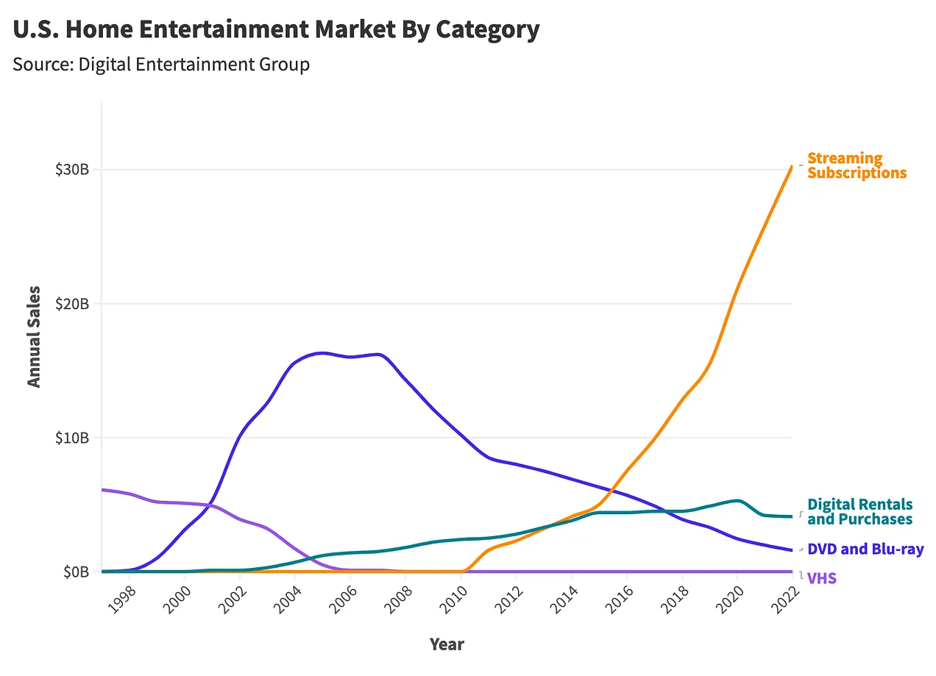
The Decline of Physical Media
VHS no longer mass produced by 2008
Blockbuster closes doors in 2014
Netflix’s shift from DVD by Mail to streaming
DVD service ended 2023
DVD sales down to $750 million from over $1 billion
Best Buy to no longer sell DVD or Blu-ray

Slide 12
Traditional Media Adaptations
Cable channels adapting their own Streaming Services
Crave, Paramount+, HBO Max, Peacock
Appeal of the subscription model over ad based revenue
Traditional broadcasts adapting for many reasons
Audience fragmentation
Competition
Content Licensing

Slide 13
Impact on the TV & Film Industry
4

Slide 14
Decline of Cable (Cord-Cutting)
Initial decline in 2013
Down 10-20% per year
Cable business model no longer working
Paying for channels that are never watched
Average 206 channels, of which only about 20 watched
Channels shifting to match the market
ESPN, HBO, and Disney
Bundled subscription inflation
3x faster than inflation between 1995 and 2005
2023, only 3 networks breaking 1 million primetime viewers
Fox News, MSNBC, and ESPN

Slide 15
Binge Watching
70% US consumers binge watch
Average 5 episodes a sitting
Changed the “Commercial Cliffhanger”
Decrease in call-backs

Slide 16
Influence on Production & Distribution
Heavy investment into original content
Shift from 22 to 10 episode seasons
Films shifting to Direct-to-Streaming
Decline in theater attendance
Less barriers to entry
Increased diversity of options

Slide 17
Cultural & Social Impacts
5

Slide 18
Audience Expectations
Viewer experience and ease of access
Full season released at once
50% more likely to watch
Original content
Subscription pricing
Average theater ticket ~$10

Slide 19
Influence on Global Consumption
More diversity in the shows available
The Sympathizer, from Vietnam
Narcos, from Colombia
Money Heist, from Spain
Allows for different cultural points of view to be shared
Provides smaller productions a chance
The Legend of Vox Machina

Slide 20
Challenges & Criticisms
6

Slide 21
Content Overload
Oversaturation of indie films
Competition with big budget films
Overwhelming amount of options
Multiple platforms
Exclusive shows
46% say they feel overwhelmed
817,000 unique titles (2022)

Slide 22
The Streaming Wars
Overload of services
Series fragmentation
Doctor Who, Max & Disney+
Price increases
Mergers
Disney+ & Hulu

Slide 23
Future Outlook
7

Slide 24
AI & Personalization
Recommendations based on your viewing history
Analyzes Thumbnails
Hulu Voice search
AI driven closed captioning

Slide 25
Emerging Trends
Streaming bundles
Profitability Over Subscribers
Ad Tiers & Pay-Per-View
Sports
Amazon offers NFL, NHL, and WNBA
Apple TV offers MLB, and MLS
Increased amount of piracy
Live Streaming
Jake Paul vs. Mike Tyson

Slide 26
Future Predictions
Social media and user generated content integration potential
Potential revival of traditional media
Legacy companies likely go through mergers
Paramount, and Warner Bros. Discovery

Slide 27
Sources
8

Slide 28
Sources
https://www.historyofinformation.com/detail.php?entryid=4684
https://www.britannica.com/technology/cable-television
https://bluebell.tv/Benefits-Of-Fibre-Optics-In-Broadcast
https://medium.com/@kennarowan/home-entertainment-evolution-c17c3f0a108e
https://www.shawdirect.ca/english/packages/programming/shaw-direct-on-demand/
https://www.bell.ca/Whats-on/On-Demand
https://www.forbes.com/home-improvement/internet/streaming-stats/
https://sites.lsa.umich.edu/mje/2024/05/25/the-rise-and-fall-of-streaming-tv/

Slide 29
Sources
https://www.wowza.com/blog/history-of-streaming-media
https://medium.com/@k-write/the-evolution-of-streaming-platforms-a-cinematic-revolution-b9e6069356df
https://www.latimes.com/entertainment-arts/business/story/2021-03-18/streaming-milestone-global-subscriptions-passed-1-billion-last-year-mpa-theme-report
https://www.statsignificant.com/p/the-rise-fall-and-slight-rise-of
https://neilmandt.com/impact-of-streaming-platforms-on-traditional-broadcast-and-cable-networks/
https://www.forbes.com/sites/bradadgate/2023/10/10/with-cord-cutting-cable-tv-industry-is-facing-financial-challenges/
https://www.investopedia.com/articles/personal-finance/062315/5-reasons-cable-tv-industry-dying.asp
https://www.forbes.com/sites/bradadgate/2024/01/03/once-again-in-2023-many-cable-networks-had-a-decline-in-audience/

Slide 30
Sources
https://foxmancommunications.com/how-does-binge-watching-tv-affect-viewers-and-storytelling/
https://www.viaccess-orca.com/blog/binge-watching-changed-way-watch-produce-television
https://motionpicture.edu/socialcinema/2023/06/19/the-impact-of-streaming-services-on-the-movie-industry/
https://edinbox.com/council/media-gmec/1156-the-impact-of-streaming-services-on-the-entertainment-industry
https://blog.filmtrack.com/industry-insights/streaming-platforms-and-their-impact-on-the-film-industry
https://www.hollywoodreporter.com/business/business-news/streaming-users-overload-choices-1235125685/
https://www.prazzleinc.com/blog/the-impact-of-streaming-platforms-on-the-indie-film-industry
https://inreviewcritics.com/2023/12/25/ridiculous-split-of-tv-shows-over-multiple-streaming-platforms-makes-case-for-physical-media-column-from-the-editor/
https://www.youtube.com/watch?v=aSClTO7nS4g&ab_channel=Tokemon

Slide 31
Sources
https://www.forbes.com/sites/neilsahota/2024/03/18/streaming-into-the-future-how-ai-is-reshaping-entertainment/
https://www.alpha-sense.com/blog/trends/streaming-platforms-key-trends-and-outlook/#key_trends_in_streaming

